Slide 1
Introduction to Software Engineering
Ref. book :
Software Engineering by Roger Pressman

Slide 2
Chapter : Topic Covered
Evolving Role of Software
Hardware vs. Software
Software characteristics
Changing nature of software
Evolution of Software
Software Myths

Slide 3
Evolving Role of Software
Software is a product
Transforms information - produces, manages, acquires, modifies, displays, or transmits information
Delivers computing potential of hardware and networks
Software is a vehicle for delivering a product
Controls other programs (operating system)
Effects communications (networking software)
Helps build other software (software tools & environments)

Slide 4
What is Software ?
Software can define as:
  Instruction – executed provide desire features, function & performance.
  Data structure – to adequately manipulate operation.
  Documents – operation and use of the program.
Software products may be developed for a particular customer or may be developed for a general market.
  Software products may be
    Generic - developed to be sold to a range of different customers e.g. PC software such as Excel or Word.
    Bespoke (custom) - developed for a single customer according to their specification.

Slide 5
Hardware vs. Software
Hardware | Software
Manufactured wear out Built using components Relatively simple | Developed/ engineered deteriorate Custom built Complex

Slide 6
Manufacturing vs. Development
Once a hardware product has been manufactured, it is difficult or impossible to modify. In contrast, software products are routinely modified and upgraded.
In hardware, hiring more people allows you to accomplish more work, but the same does not necessarily hold true in software engineering.
Unlike hardware, software costs are concentrated in design rather than production.

Slide 7
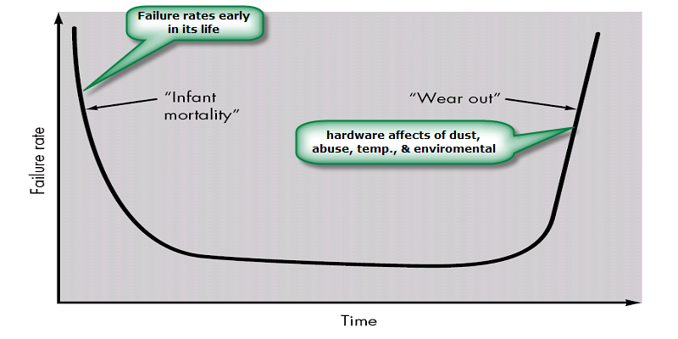
Failure curve for Hardware

Slide 8
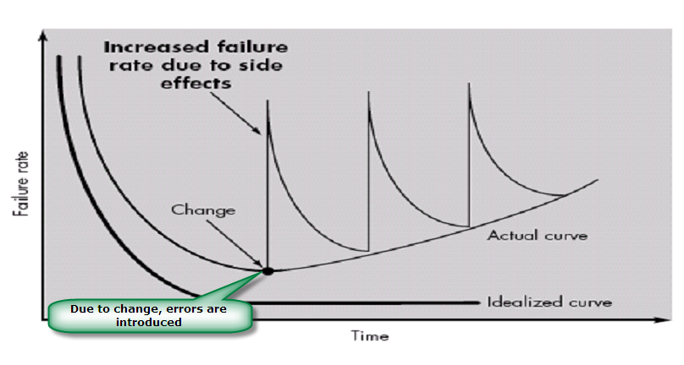
Failure curve for Software
When a hardware component wears out, it is replaced by a spare part.
There are no software spare parts. Every software failure indicates an error in design or in the process through which design was translated into machine executable code. Therefore, software maintenance involves considerably more complexity

Slide 9
Component Based vs. Custom Built
Hardware products typically employ many standardized design components.
Most software continues to be custom built.
The software industry does seem to be moving (slowly) toward component-based construction.

Slide 10
Software characteristics
Software is developed or engineered; it is not manufactured.
Software does not “wear out” but it does deteriorate.
Software continues to be custom built, as industry is moving toward component based construction.

Slide 11
Changing nature of software
System software
Application software
Engineering/scientific software
Embedded software
Product line software
Web applications
Artificial intelligence software

Slide 12
System Software:
System software is a collection of programs written to service other programs.
It is characterized by heavy interaction with computer hardware; heavy usage by multiple users; concurrent operation that requires scheduling, resource sharing, and sophisticated process management; complex data structures; and multiple external interfaces.
Ex. Compilers, operating system, drivers etc.
Application Software :
Application software consists of standalone programs that solve a specific business need.
Application software is used to control the business function in real-time.
Engineering /Scientific software:
Characterized by "number crunching" algorithms.
Applications range from astronomy to volcano logy, from automotive stress analysis to space shuttle orbital dynamics, and from molecular biology to automated manufacturing.
Ex. Computer Aided Design (CAD), system stimulation etc.

Slide 13
Embedded Software:
It resides in read-only memory and is used to control products and systems
Embedded software can perform limited and esoteric functions.
Ex. keypad control for a microwave oven.
Product line software:
Designed to provide a specific capability for use by many different customers, product line software can focus on a limited and esoteric marketplace.
Ex. Word processing, spreadsheet, CG, multimedia, etc.
Web Applications:
Web apps can be little more than a set of linked hypertext files.
It evolving into sophisticated computing environments that not only provide standalone features, functions but also integrated with corporate database and business applications.
Artificial Intelligence software
AI software makes use of non-numerical algorithms to solve complex problems that are not amenable to computation or straightforward analysis
Ex. Robotics, expert system, game playing, etc.

Slide 14
Software Evolution
The Law of Continuing Change (1974): E-type (Real world implemented) systems must be continually adapted else they become progressively less satisfactory.
The Law of Increasing Complexity (1974): As an E-type system evolves its complexity increases unless work is done to maintain or reduce it.
The Law of Self Regulation (1974): The E-type system evolution process is self-regulating with distribution of product and process measures close to normal.
The Law of Conservation of Organizational Stability (1980): The average effective global activity rate in an evolving E-type system is invariant over product lifetime.

Slide 15
Software Evolution
The Law of Conservation of Familiarity (1980): As an E-type system evolves all associated with it, developers, sales personnel, users, for example, must maintain mastery of its content and behavior to achieve satisfactory evolution.
The Law of Continuing Growth (1980): The functional content of E-type systems must be continually increased to maintain user satisfaction over their lifetime.
The Law of Declining Quality (1996): The quality of E-type systems will appear to be declining unless they are rigorously maintained and adapted to operational environment changes.
The Feedback System Law (1996): E-type evolution processes constitute multi-level, multi-loop, multi-agent feedback systems and must be treated as such to achieve significant improvement over any reasonable base.

Slide 16
Software Myths
Definition: Beliefs about software and the process used to build it. Myths have number of attributes that have made them insidious (i.e. dangerous).
Misleading Attitudes - caused serious problem for managers and technical people.
Management myths
Managers in most disciplines, are often under pressure to maintain budgets, keep schedules on time, and improve quality.
Myth1: We already have a book that's full of standards and procedures for building
software, won't that provide my people with everything they need to know?
Reality :
Are software practitioners aware of existence standards?
Does it reflect modern software engineering practice?
Is it complete? Is it streamlined to improve time to delivery while still maintaining a focus on quality?

Slide 17
Myth2: If we get behind schedule, we can add more programmers and catch up
Reality: Software development is not a mechanistic process like manufacturing. Adding people to a late software project makes it later.
People can be added but only in a planned and well-coordinated manner
Myth3: If I decide to outsource the software project to a third party, I can just relax and let that firm build it.
Reality: If an organization does not understand how to manage and control software projects internally, it will invariably struggle when it outsource software projects

Slide 18
Customer Myths
Customer may be a person from inside or outside the company that has requested software under contract.
Myth: A general statement of objectives is sufficient to begin writing programs— we can fill in the details later.
Reality: A poor up-front definition is the major cause of failed software efforts. A formal and detailed description of the information domain, function, behavior, performance, interfaces, design constraints, and validation criteria is essential. These characteristics can be determined only after thorough communication between customer and developer.
Myth: Project requirements continually change, but change can be easily accommodated because software is flexible.
Reality: Customer can review requirements and recommend modifications with relatively little impact on cost. When changes are requested during software design, the cost impact grows rapidly. Below mentioned figure for reference.

Slide 19
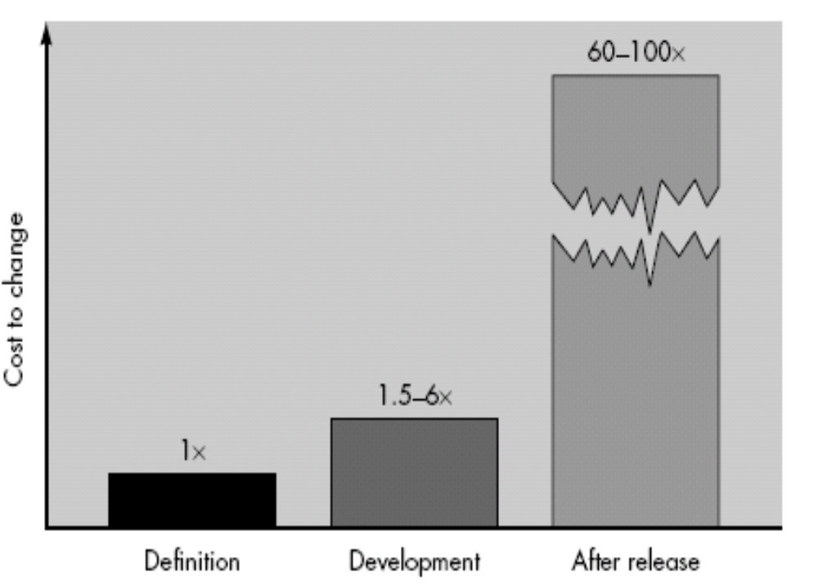

Slide 20
Practitioner's myths
Myth1: Once we write the program and get it to work, our job is done.
Reality: Someone once said that "the sooner you begin 'writing code', the longer it'll take you to get done." Industry data indicate that between 60 and 80 percent of all effort expended on software will be expended after it is delivered to the customer for the first time.
Myth2: Until I get the program "running" I have no way of assessing its quality.
Reality: One of the most effective software quality assurance mechanisms can be applied from the inception of a project—the formal technical review.
Myth3: The only deliverable work product for a successful project is the working program.

Slide 21
Reality: A working program is only one part of a software configuration that includes many elements. Documentation provides a foundation for successful engineering and, more important, guidance for software support.
Myth4 : Software engineering will make us create voluminous and unnecessary documentation and will invariably slow us down.
Reality: Software engineering is not about creating documents. It is about creating
quality. Better quality leads to reduced rework. And reduced rework results in faster delivery times.

Slide 22
Software Process

Slide 23
Chapter - Topic Covered
Layered Technology
Software Process Framework
Generic Process Framework Activities
Umbrella Activities
CMMI Level

Slide 24
Overview
What? A software process – as a framework for the tasks that are required to build high-quality software.
Who? Managers, software engineers, and customers.
Why? Provides stability, control, and organization to an otherwise chaotic activity.
Steps? A handful of activities are common to all software processes, details vary.
Work product? Programs, documents, and data.

Slide 25
What is software engineering?
Definition :
  (1) The application of systematic, disciplined, quantifiable approach to the development, operation, and maintenance of software; that is, the application of engineering to software.(2) The study of approaches as in (1) above
Its a discipline that is concerned with all aspects of software production.
Software engineers should adopt
  Systematic and organized approach to their work
  Use appropriate tools and techniques depending on the problem to be solved
  The development constraints and the resources available
Apply Engineering Concepts to developing Software
Challenge for Software Engineers is to produce high quality software with finite amount of resources & within a predicted schedule

Slide 26
Software Engineering – Layered Technology
Layered Technology
Tools: CASE preferred
Methods: technical “how to’s”
Process model: the “framework”
A quality focus: the “bedrock”

Slide 27
Layered Technology
A quality Focus
Every organization is rest on its commitment to quality.
Total quality management, Six Sigma, or similar continuous improvement culture and it is this culture ultimately leads to development of increasingly more effective approaches to software engineering.
The bedrock that supports software engineering is a quality focus.
Process:
It’s a foundation layer for software engineering.
It’s define framework for a set of key process areas (KRA) for effectively manage and deliver quality software in a cost effective manner
The processes define the tasks to be performed and the order in which they are to be performed

Slide 28
Layered Technology
Methods:
It provide the technical how-to's for building software.
Methods encompass a broad array of tasks that include requirements analysis, design, program construction, testing, and support.
There could be more than one technique to perform a task and different techniques could be used in different situations.
Tools:
Provide automated or semi-automated support for the process, methods and quality control.
When tools are integrated so that information created by one tool can be used by another, a system for the support of software development, called computer-aided software engineering (CASE)

Slide 29
Process Framework
Software Process
Process Framework
Umbrella Activities
Process framework
Umbrella Activities
  Framework activities
  work tasks
    work products
    milestones & deliverables
    QA checkpoints
Framework activity 1
Framework activity n

Slide 30
Process framework
Why process :
A process defines who is doing what, when and how to reach a certain goal.
To build complete software process.
Identified a small number of framework activities that are applicable to all software projects, regardless of their size or complexity.
It encompasses a set of umbrella activities that are applicable across the entire software process.

Slide 31
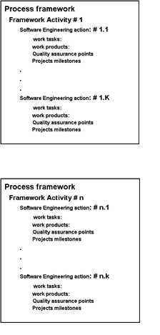
Process Framework
Each framework activities is populated by a set for software engineering actions – a collection of related tasks.
Each action has individual work task.

Slide 32
Generic Process Framework Activities
Communication:
  Heavy communication with customers, stakeholders, team
  Encompasses requirements gathering and related activities
Planning:
  Workflow that is to follow
  Describe technical task, likely risk, resources will require, work products to be produced and a work schedule.
Modeling:
  Help developer and customer to understand requirements (Analysis of requirements) & Design of software
Construction
  Code generation: either manual or automated or both
  Testing – to uncover error in the code.
Deployment:
  Delivery to the customer for evaluation
  Customer provide feedback

Slide 33
The Process Model: Adaptability
The framework activities will always be applied on every project ... BUT
The tasks for each activity will vary based on:
  The type of project (an “entry point” to the model)
  Characteristics of the project
  Common sense judgment; concurrence of the project team

Slide 34
Umbrella Activities
Software project tracking and control
  Assessing progress against the project plan.
  Take adequate action to maintain schedule.
Formal technical reviews
  Assessing software work products in an effort to uncover and remove errors before goes into next action or activity.
Software quality assurance
  Define and conducts the activities required to ensure software quality.
Software configuration management
  Manages the effects of change.
Document preparation and production
  Help to create work products such as models, documents, logs, form and list.
Reusability management
  Define criteria for work product reuse
  Mechanisms to achieve reusable components.
Measurement
  Define and collects process, project, and product measures
  Assist the team in delivering software that meets customer’s needs.
Risk management
  Assesses risks that may effect that outcome of project or quality of product (i.e. software)

Slide 35
Capability Maturity Model Integration (CMMI)
The Software Engineering Institute (SEI) has developed process meta-model to measure organization different level of process capability and maturity.
CMMI – developed by SEI
The CMMI defines each process area in terms of “specific goals” and the “specific practices” required to achieve these goals.
Specific goals establish the characteristics that must exist if the activities implied by a process area are to be effective.
Specific practices refine a goal into a set of process-related activities.

Slide 36
CMMI Level
Level 0 (Incomplete) –
  Process are not perform or not achieve all the goals and objectives defined by the CMMI for Level I capability.
Level 1 (Performed) – All specific goals are performed as per defined by CMMI
Level 2 (Managed) –
  All level 1 criteria have been satisfied
  In addition to Level I;
    People doing work have access to adequate resources to get job done,
    Stakeholders are actively involved,
    Work tasks and products are monitored, controlled, reviewed, and evaluated for conformance to process description.
Level 3 (Defined) –
  All level 2 criteria have been achieved.
  In addition;
    management and engineering processes documented
    standardized and integrated into organization-wide software process

Slide 37
CMMI Level (cont.)
Level 4 (Quantitatively Managed) -
  All level 3 criteria have been satisfied.
  Software process and products are quantitatively understood
  Controlled using detailed measures and assessment.
Level 5 (Optimized) –
  Continuous process improvement is enabled by quantitative feedback from the process and testing innovative ideas.

Slide 38
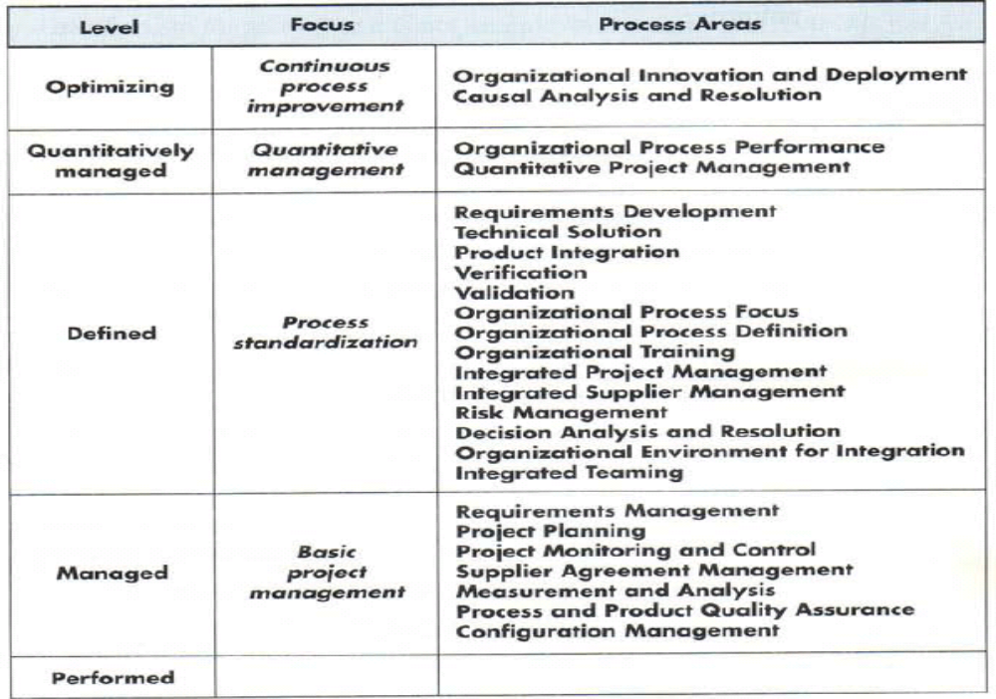

Slide 39
Software Process Model

Slide 40
Chapter : Topic Covered
About software process model
Build and Fix Model
Why Models are needed?
  Process as a "black box“ & Problem
  Process as a “white box“ & Advantage
Prescriptive Model
Waterfall Model or Linear Sequential
Incremental Process Models
  Incremental Model
  RAD Model
Evolutionary Process Models
  Prototyping
  Spiral Model
  Concurrent Development Model
  Fourth Generation Techniques (4GT)
  Component based development (CBD)

Slide 41
Software process model
Process models prescribe a distinct set of activities, actions, tasks, milestones, and work products required to engineer high quality software.
Process models are not perfect, but provide roadmap for software engineering work.
Software models provide stability, control, and organization to a process that if not managed can easily get out of control
Software process models are adapted to meet the needs of software engineers and managers for a specific project.

Slide 42
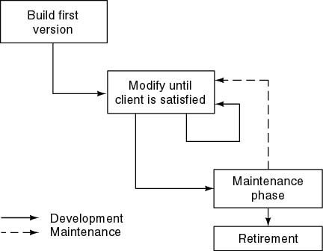
Build and Fix Model

Slide 43
Build and Fix Model
The earlier approach
Product is constructed without specification or any attempt at design.
developers simply build a product that is reworked as many times as necessary to satisfy the client.
model may work for small projects but is totally unsatisfactory for products of any reasonable size.
Maintenance is high.
Source of difficulties and deficiencies
  impossible to predict
  impossible to manage

Slide 44
Why Models are needed?
Symptoms of inadequacy: the software crisis
  scheduled time and cost exceeded
  user expectations not met
  poor quality

Slide 45
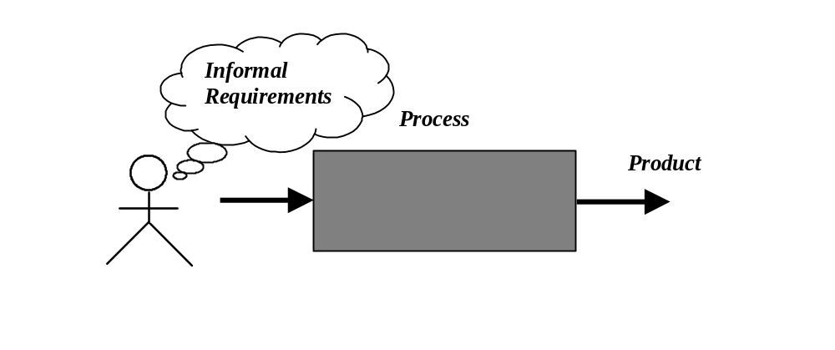
Process as a "black box"
Quality?
Uncertain /
Incomplete requirement
In the beginning

Slide 46
Problems
The assumption is that requirements can be fully understood prior to development
Interaction with the customer occurs only at the beginning (requirements) and end (after delivery)
Unfortunately the assumption almost never holds

Slide 47
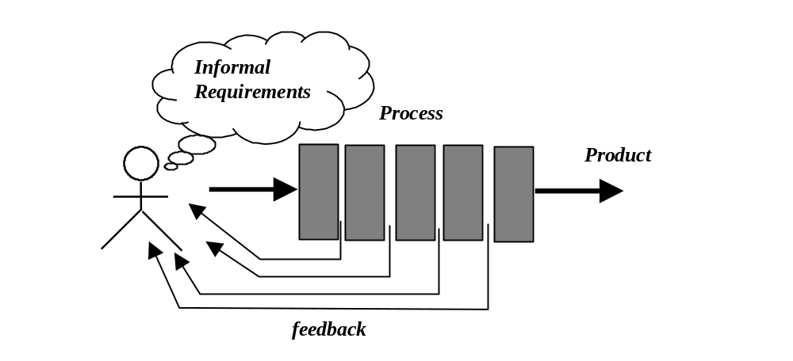
Process as a "white box"

Slide 48
Advantages
Reduce risks by improving visibility
Allow project changes as the project progresses
  based on feedback from the customer

Slide 49
Prescriptive Model
Prescriptive process models advocate an orderly approach to software engineering
  Organize framework activities in a certain order
Process framework activity with set of software engineering actions.
Each action in terms of a task set that identifies the work to be accomplished to meet the goals.
The resultant process model should be adapted to accommodate the nature of the specific project, people doing the work, and the work environment.
Software engineer choose process framework that includes activities like;
  Communication
  Planning
  Modeling
  Construction
  Deployment

Slide 50
Prescriptive Model
Calling this model as “Prescribe” because it recommend a set of process elements, activities, action task, work product & quality.
Each elements are inter related to one another (called workflow).

Slide 51
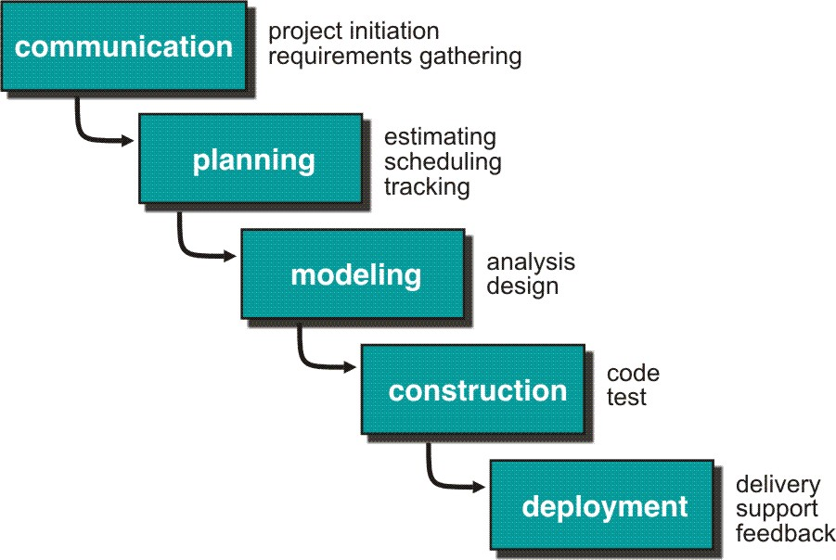
Waterfall Model or Classic Life Cycle

Slide 52
Waterfall Model or Classic Life Cycle
Requirement Analysis and Definition: What - The systems services, constraints and goals are defined by customers with system users.
Scheduling tracking -
  Assessing progress against the project plan.
  Require action to maintain schedule.
System and Software Design: How –It establishes and overall system architecture. Software design involves fundamental system abstractions and their relationships.
Integration and system testing: The individual program unit or programs are integrated and tested as a complete system to ensure that the software requirements have been met. After testing, the software system is delivered to the customer.
Operation and Maintenance: Normally this is the longest phase of the software life cycle. The system is installed and put into practical use. Maintenance involves correcting errors which were not discovered in earlier stages of the life-cycle.

Slide 53
Limitations of the waterfall model
The nature of the requirements will not change very much During development; during evolution
The model implies that you should attempt to complete a given stage before moving on to the next stage
  Does not account for the fact that requirements constantly change.
  It also means that customers can not use anything until the entire system is complete.
The model implies that once the product is finished, everything else is maintenance.
Surprises at the end are very expensive
Some teams sit ideal for other teams to finish
Therefore, this model is only appropriate when the requirements are well-understood and changes will be fairly limited during the design process.
Problems:
Real projects are rarely follow the sequential model.
Difficult for the customer to state all the requirement explicitly.
Assumes patience from customer - working version of program will not available until programs not getting change fully.

Slide 54
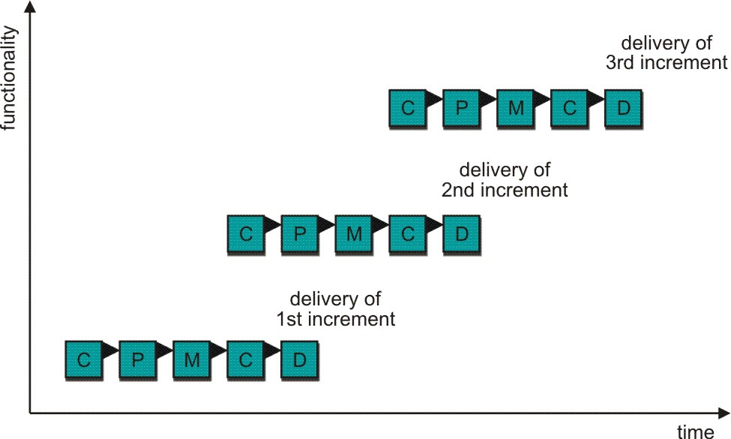
Incremental Process Model
C- Communication
P - Planning
M – Modeling
C - Construction
D - Deployment
Delivers software in small but usable pieces, each piece builds on pieces already delivered

Slide 55
The Incremental Model
Rather than deliver the system as a single delivery, the development and delivery is broken down into increments with each increment delivering part of the required functionality.
First Increment is often core product
  Includes basic requirement
  Many supplementary features (known & unknown) remain undelivered
A plan of next increment is prepared
  Modifications of the first increment
  Additional features of the first increment
It is particularly useful when enough staffing is not available for the whole project
Increment can be planned to manage technical risks.
Incremental model focus more on delivery of operation product with each increment.

Slide 56
The Incremental Model
User requirements are prioritised and the highest priority requirements are included in early increments.
Once the development of an increment is started, the requirements are frozen though requirements for later increments can continue to evolve.
Customer value can be delivered with each increment so system functionality is available earlier.
Early increments act as a prototype to help elicit requirements for later increments.
Lower risk of overall project failure.
The highest priority system services tend to receive the most testing.

Slide 57
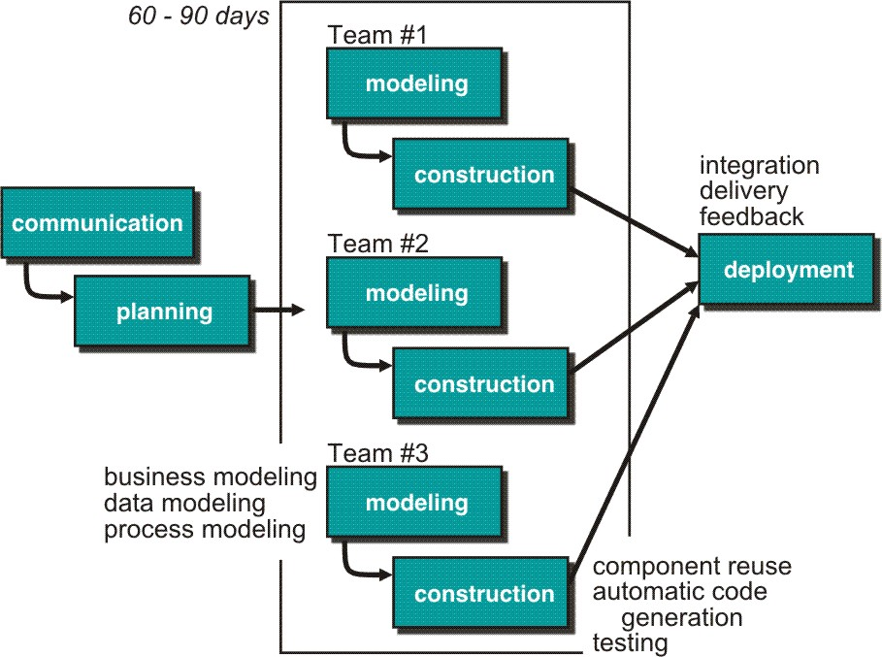
Rapid Application Development (RAD) Model
Makes heavy use of reusable software components with an extremely short development cycle

Slide 58
RAD model
Communication – to understand business problem.
Planning – multiple s/w teams works in parallel on diff. system.
Modeling –
  Business modeling – Information flow among business is working.
  Ex. What kind of information drives?
  Who is going to generate information?
  From where information comes and goes?
  Data modeling – Information refine into set of data objects that are needed to support business.
  Process modeling – Data object transforms to information flow necessary to implement business.

Slide 59
Construction – it highlighting the use of pre-existing software component.
Deployment – Deliver to customer basis for subsequent iteration.
RAD model emphasize a short development cycle.
“High speed” edition of linear sequential model.
If requirement are well understood and project scope is constrained then it enable development team to create “ fully functional system” within a very short time period.

Slide 60
RAD Model
If application is modularized (“Scalable Scope”), each major function to be completed in less than three months.
Each major function can be addressed by a separate team and then integrated to form a whole.
Drawback:
For large but scalable projects
  RAD requires sufficient human resources
Projects fail if developers and customers are not committed in a much shortened time-frame
Problematic if system can not be modularized
Not appropriate when technical risks are high ( heavy use of new technology)

Slide 61
Evolutionary Process Model
Produce an increasingly more complete version of the software with each iteration.
Evolutionary Models are iterative.
Evolutionary models are:
  Prototyping
  Spiral Model
  Concurrent Development Model
  Fourth Generation Techniques (4GT)

Slide 62
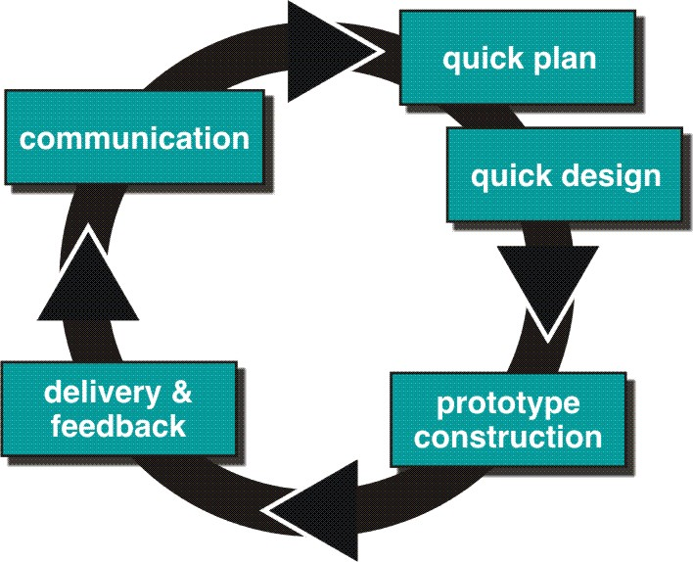
Evolutionary Process Models : Prototyping

Slide 63
Prototyping cohesive
Best approach when:
  Objectives defines by customer are general but does not have details like input, processing, or output requirement.
  Developer may be unsure of the efficiency of an algorithm, O.S., or the form that human machine interaction should take.
It can be used as standalone process model.
Model assist software engineer and customer to better understand what is to be built when requirement are fuzzy.
Prototyping start with communication, between a customer and software engineer to define overall objective, identify requirements and make a boundary.
Going ahead, planned quickly and modeling (software layout visible to the customers/end-user) occurs.
Quick design leads to prototype construction.
Prototype is deployed and evaluated by the customer/user.
Feedback from customer/end user will refine requirement and that is how iteration occurs during prototype to satisfy the needs of the customer.

Slide 64
Prototyping (cont..)
Prototype can be serve as “the first system”.
Both customers and developers like the prototyping paradigm.
  Customer/End user gets a feel for the actual system
  Developer get to build something immediately.
Problem Areas:
Customer cries foul and demand that “a few fixes” be applied to make the prototype a working product, due to that software quality suffers as a result.
Developer often makes implementation in order to get a prototype working quickly without considering other factors in mind like OS, Programming language, etc.
Customer and developer both must be agree that the prototype is built to serve as a mechanism for defining requirement.

Slide 65
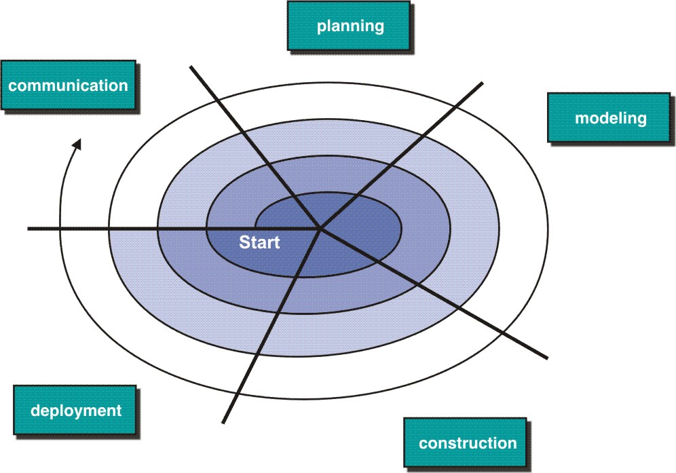
Evolutionary Model: Spiral Model

Slide 66
Spiral Model
Couples iterative nature of prototyping with the controlled and systematic aspects of the linear sequential model
It provide potential for rapid development of increasingly more complete version of the software.
Using spiral, software developed in as series of evolutionary release.
  Early iteration, release might be on paper or prototype.
  Later iteration, more complete version of software.
Divided into framework activities (C,P,M,C,D). Each activity represent one segment.
Evolutionary process begins in a clockwise direction, beginning at the center risk.
First circuit around the spiral might result in development of a product specification. Subsequently, develop a prototype and then progressively more sophisticated version of software.
Unlike other process models that end when software is delivered.
It can be adapted to apply throughout the life of software.

Slide 67
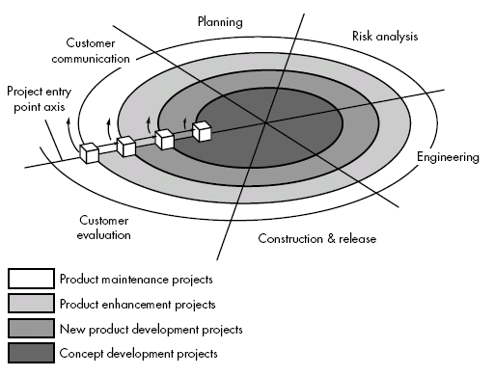
Spiral Model

Slide 68
Spiral Model (cont.)
Concept Development Project:
Start at the core and continues for multiple iterations until it is complete.
If concept is developed into an actual product, the process proceeds outward on the spiral.
New Product Development Project:
New product will evolve through a number of iterations around the spiral.
Later, a circuit around spiral might be used to represent a “Product Enhancement Project”
Product Enhancement Project:
There are times when process is dormant or software team not developing new things but change is initiated, process start at appropriate entry point.

Slide 69
Spiral models uses prototyping as a risk reduction mechanism but, more important, enables the developer to apply the prototyping approach at each stage in the evolution of the product.
It maintains the systematic stepwise approach suggested by the classic life cycle but also incorporates it into an iterative framework activity.
If risks cannot be resolved, project is immediately terminated
Problem Area:
It may be difficult to convince customers (particularly in contract situations) that the evolutionary approach is controllable.
If a major risk is not uncovered and managed, problems will undoubtedly occur.

